Slide 1
A Personal Privacy Preserving Framework: I Let You Know Who Can See What
Xuemeng Song†, Xiang Wang‡, Liqiang Nie†, Xiangnan He‡, Zhumin Chen† , Wei Liu$
†School of Computer Science and Technology, Shandong University
‡School of Computing, University of National Singapore, Singapore
$Tencent AI Lab
Notes:
Hello, everyone. I am Liu Qian from Shandong University. Since the authors failed to get the visa, I will help them present their work: A personal privacy preserving framework: I let you know who can see what.

Slide 2
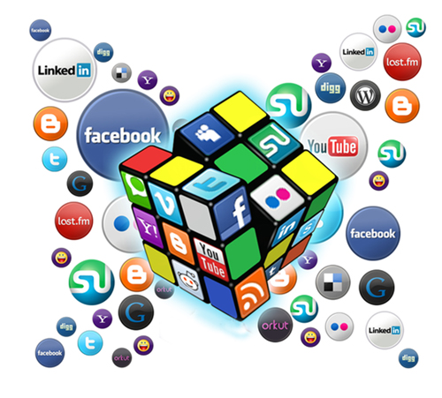

Motivation
Personal demographics
Daily activities
Relationship
…
Information pertaining to users themselves accounts for up to 66% of the entire user generated contents (UGCs) [1].
Notes:
With the increasing enthusiasm of users for sharing their daily lives on social networks, a large amount of personal data are made publicly available, such as personal demographics, daily activities and even relationship with others. Therefore, these data may put users at high privacy risks due to the following reasons.

Slide 3

Motivation
Personal demographics
Daily activities
Relationship
…
Information pertaining to users themselves accounts for up to 66% of the entire user generated contents (UGCs) [1].
Notes:
With the increasing enthusiasm of users for sharing their daily lives on social networks, a large amount of personal data are made publicly available, such as personal demographics, daily activities and even relationship with others. Therefore, these data may put users at high privacy risks due to the following reasons.

Slide 4
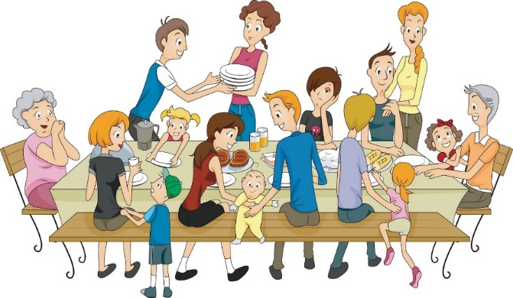

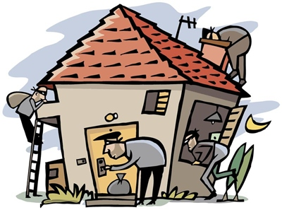
Motivation
The default privacy settings usually make UGCs publicly accessible.
A real story…
June 2009
Looking forward to my family vacation to Saint Louis, where we would be visiting family friends for the week.
Vacation at Saint Louis
Video podcaster
We had successfully arrived in Missouri.
Home in Arizona
Notes:
First, the default settings usually make the most UGCs publicly accessible. As a result, the UGCs have a large chance to be seen by unexpected audience which may cause unexpected effects to users. Take a real story as an example. A video podcaster posted his detailed vocation plan in tweets, like this(图中的tweets内容). Then when they were enjoying the family party at Saint Louis, guess what happened? It is a sad story. His Arizona home got broken-in.

Slide 5
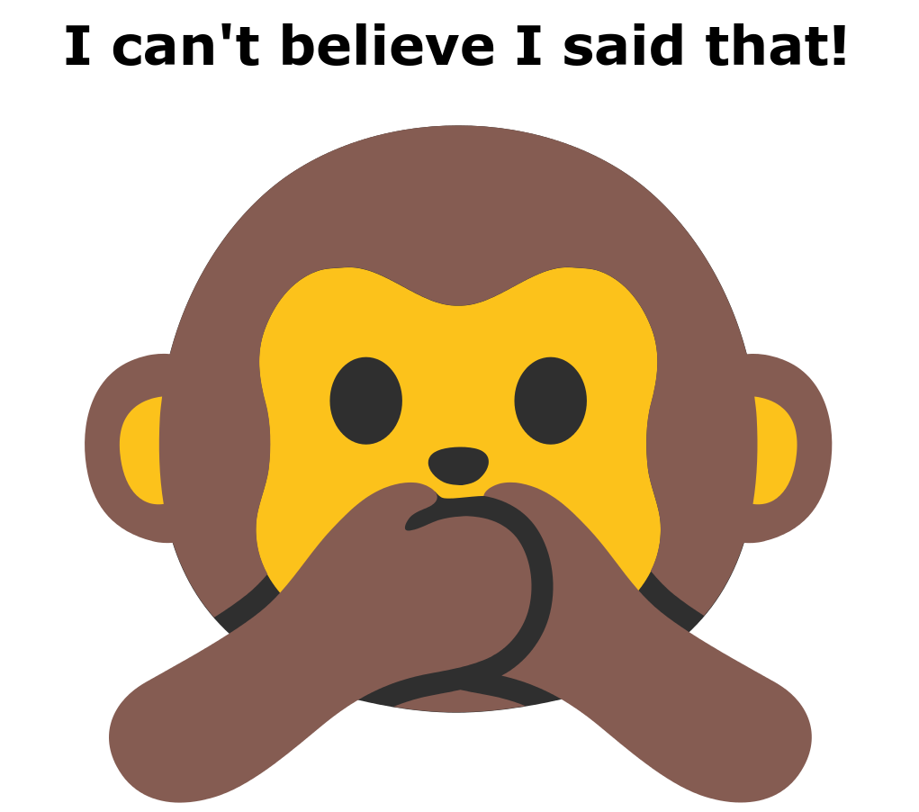
Motivation
Users may even be unaware of the privacy leakage when they are posting on social networks, which leads to the regrettable messages [1].
Privacy leakage via UGCs deserves our special attention.
Regrettable messages
[1] Sleeper, M.; Cranshaw, J.; Kelley, P. G.; Ur, B.; Acquisti, A.; Cranor, L. F.; and Sadeh, N. 2013. I read my twitter the next morning and was astonished: A conversational perspective on twitter regrets. In SIGCHI.
Notes:
Second, users may even be unaware of the privacy leakage when they are posting on social networks. that is why there are regrettable messages. I guess some of you may also deleted what you have posted. According to this work, regretted posts were usually created during highly emotional “hot states”… So we may leak our privacy unawarely. Therefore, Privacy leakage via UGCs deserves our special attention.

Slide 6
Related Work
Privacy
Structured Data
Unstructured Data
User structured profiles,
User generated contents.
Privacy settings,
Trajectory records…
Far too little attention has been paid to investigate users’ unstructured data, whereby the data volume is larger, information is richer, and privacy issues are more prominent.
Mainly focus on training eﬀective classifiers to predict whether the given UGC is privacy-sensitive.
Notes:
In fact, users' growing concern regarding their privacy leakage on social media has attracted many researchers. However, most of them studied privacy leakage in social media on the well-structured data, such as users structured profiles, privacy settings and users' trajectory records. Far too little attention has been paid to investigate users' unstructured data, e.g., users' micro-blogs, whereby the information is richer and privacy issues are more prominent. As far as we know, these work mainly focus on training eﬀective classifiers to predict whether the given UGC is privacy-sensitive.

Slide 7
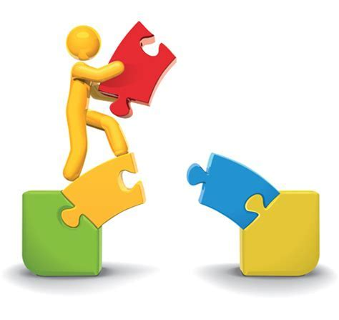
Related Work
Multi-task Learning
Although multi-task learning has been successfully applied to
Social behavior prediction,
Image annotation,
Web search,
…
Limited efforts have been dedicated to the privacy domain.
Notes:
In addition, multi-task learning works by jointly solving a problem together with other related problems simultaneously, using a shared representation. This often leads to a better model for the research. For example, multi-task learning has been successfully applied to the social behavior prediction, image annotation, web search, and so on. However, limited efforts have been dedicated to the privacy domain, which is the major concern of our work.

Slide 8
Task Definition
Considering that information and audience both play pivotal roles in the
privacy preserving, answering the question of Who Can See What is essential.
Family members
Close friends
Casual friends
Outsider audience
Tweet
Looking forward to my family vacation to Saint Louis, where we would be visiting family friends for the week.
√
Privacy Preserving
√
×
×
Input
Information
Output
Audience
Notes:
Considering that information and audience both play pivotal roles in the privacy preserving, we aims to answer the question of Who Can See What. In other words, we aim to devise a privacy preserving framework, which is able to remind users the appropriate audience for the given tweet.

Slide 9
Challenges
The personal aspects of users conveyed by their UGCs are usually not independent but related. The main challenge is how to construct and leverage the relatedness structure to boost the performance.
No gold standard instruction is available to guide Who Can See What.
The lack of benchmark dataset and the way to extract a set of privacy-oriented features.
Notes:
However, answering Who Can See What is non-trivial due to the following reasons. Firstly, the personal aspects of users conveyed by their posts are usually not independent but can be organized into certain structures, such as groups, according to their relatedness. Such relatedness structure can impose certain constraints to the feature space and enhance the performance of aspect detection. The first challenge is how to construct and leverage the relatedness structure to boost the performance.
Secondly, thus far, no gold standard guideline is available to guide Who Can See What. This poses a crucial challenge.
The third challenge lies in the lack of the benchmark dataset and the way to extract a set of privacy-oriented features.

Slide 10
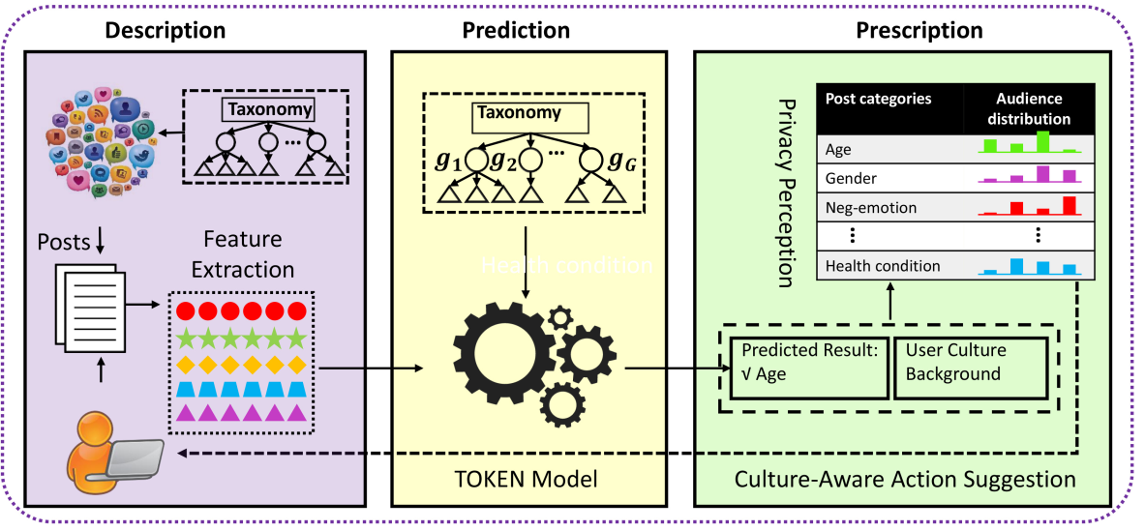
Framework
Figure 1: Illustration of the proposed scheme.
Notes:
To address the aforementioned challenges, we present a novel scheme for boundary regulation, comprising of three components: description, prediction, and prescription. First, we build a comprehensive taxonomy of the personal aspects, collect a benchmark dataset and extract a rich set of privacy-oriented features from the UGCs. Second, we introduce a taxonomy-constrained model to detect the potential privacy leakage. Last, we suggest users with the possible actions according to the guidelines built via AMT .
Next, we will introduce each component in details one by one.

Slide 11
Description
Taxonomy Induction
Caliskan-Islam et al. 2014
Location
Personal Attacks
Medical
Drug
Personal Details
Emotion
Stereotying
Identifiable Information
Associations
Coarse-grained.
Overlook the life milestones of individuals.
Figure 2. Illustration of our pre-defined taxonomy.
Notes:
Caliskan-Islam et al. 2014, argues that the private information can fall under one or more of the following 9 categories. These categories are relatively coarse-grained and hence fail to provide more detailed privacy leakage. In addition, they overlook the life milestones aspect of individuals, which can also be privacy related according to the literature. Therefore, in this work, by summarizing the literature, we establish a comprehensive taxonomy to characterize users' personal aspects, which consists of 32 privacy-aware aspects under eight general groups. These categories can be organized into eight groups, namely, personal attributes, relationship, activities, location, emotion, healthcare, life milestones and neutral statements. Except the neutral statements group, categories in the other seven groups are all related to personal issues to some extent.

Slide 12

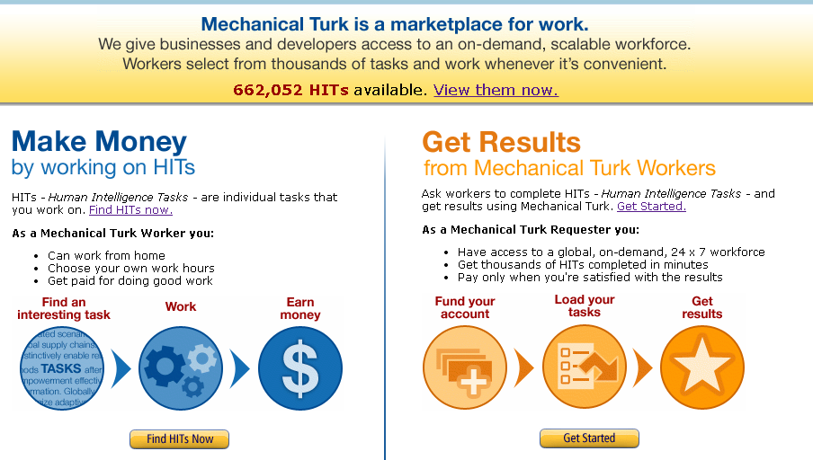


Description
Data Collection
Users’ tweets revealing their personal aspects are usually sparse, we hence give up the user-centric crawling policy.
Twitter Search Service
Ground Truth Construction
Pre-defined
keywords
269, 090 raw tweets.
Three “masters” are employed for tweet annotations.
11,370 tweets.
Notes:
To build our dataset, considering that most of users’ private tweets are extremely sparse, we hence did not collect data by following the user-centric policy. Instead, we collected the social posts for each category in the pre-defined taxonomy by respective keywords. With the twitter search service, we obtained 269, 090 raw tweets. To improve the quality of the dataset, we filtered out tweets that contain external URLs excluding those referring to users’ other social networks’ (e.g., Instagram) posts. In addition, as we study the first-order privacy leakage, we ignored retweets in the dataset. Finally, we get 11, 370 tweets. In our work, we constructed the ground truth about what has been revealed by a given post via AMT. We required workers to annotate each post with multiple categories. To ensure the quality of our ground truth, we only employed the AMT masters instead of common workers. AMT masters achieve the “master” distinction by satisfying the demand with a high degree of accuracy.

Slide 13
Description
Example Illustration
Table1. Examples of selected categories.
Notes:
To get a more intuitive understanding of each category, we take a close look at the samples of each category. Table 1 lists a few examples of selected categories. We found that users’ occupations are mainly revealed by tweeting their new jobs, their feelings about the work, or self promotion. Users’ gender information can be embedded in their roles in relationships (e.g., daughter, wife) or the distinct gender characteristics (e.g., period for women).

Slide 14
Description
Features
Linguistic Inquiry Word Count (LIWC)
Privacy Dictionary
Sentiment Analysis
Sentence2Vector
Meta-features
Notes:
To capture the user’s personal leakage, we extracted a rich set of privacy-oriented features.

Slide 15


Description
Features
Linguistic Inquiry Word Count (LIWC)
Privacy Dictionary
Dictionary
Word category
Sentiment Analysis
Sentence2Vector
Meta-features
Percentage (%)
Category
Notes:
The first one is the LIWC feature. is a psycholinguistic transparent lexicon analysis tool, and its eﬀectiveness has been extensively validated in users’ personality. Considering that users’ personality traits significantly aﬀect their behaviors, including privacy perceptions, we adopted the LIWC feature to capture the sensitivity of a given UGC. The main component of LIWC is a dictionary, containing the
mappings from words to 70 categories. Given a document, LIWC generates a vector to represent the percentage of words falling into each category.

Slide 16
Description
Features
Table2. Eight categories of the privacy dictionary.
Linguistic Inquiry Word Count (LIWC)
Category | Explanation
OpenVisible | Represents the dialectic openness of privacy. (e.g., display, accessible.)
OutcomeState | Describes the static behavioral states and the outcomes that are served throughPrivacy. (e.g, freedom, alone.)
NormsRequisites | Encapsulates the norms, beliefs, and expectations in relation to achieving privacy. (e.g., consent, respect.)
Restriction | Expresses the closed, restrictive, and regulatory behaviors employed in maintaining privacy. (e.g., lock, exclude.)
NegativePrivacy | Captures the antecedents and consequences of privacy violations. (e.g., troubled, interfere.)
Intimacy | Portrays and measures different facets of small-group privacy. (e.g., trust, friendship.)
PrivateSecret | Expresses the “content” of privacy. (e.g., secret, data.)
Law | Describes legal definitions of privacy. (e.g., offence.)
Privacy Dictionary
Sentiment Analysis
Sentence2Vector
Meta-features
Notes:
The privacy dictionary is a new linguistic resource for automated content analysis on privacy related texts. We believe that sensitive UGCs should contain some typical privacy related keywords. We hence employed this dictionary to discriminate sensitive and non-sensitive UGCs. With this dictionary, we can generate similar outputs as LIWC does.

Slide 17

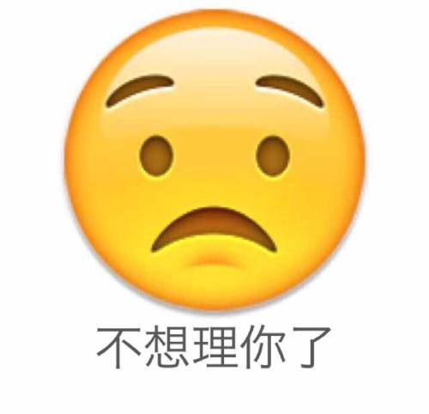
Description
Features
Linguistic Inquiry Word Count (LIWC)
Personal Aspects
Privacy Dictionary
● Graduation
● Have babies
● Career promotion
● Medical treatment
● Passing away of relatives
Sentiment Analysis
Sentence2Vector
Meta-features
Stanford NLP sentiment classifier
Notes:
Diﬀerent personal aspects are frequently conveyed diﬀerent sentiments. For example, we observed that people usually broadcast their graduation and becoming parents in a more positive way, while describe their medical treatments in a more negative way.

Slide 18
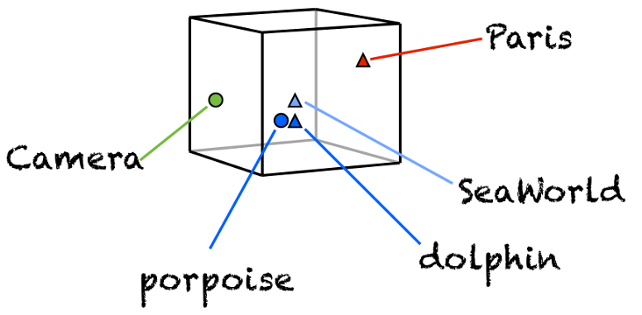
Description
Features
Linguistic Inquiry Word Count (LIWC)
Developed based on Word2Vector . Given a tweet, Word2Vector would project it to a fixed dimensional space, where similar words are encoded spatially.
Privacy Dictionary
Sentiment Analysis
Sentence2Vector
Meta-features
Notes:
Considering the short-length nature of tweet, to perform content analysis, we employed the state-of-the-art textual feature extraction tool Sentence2Vector. Sentence2Vector is developed based on the word embedding algorithm Word2Vector. Given a UGC, Word2Vector would project it to a fixed dimensional space, where similar words are encoded spatially.

Slide 19
Description
Features
Linguistic Inquiry Word Count (LIWC)
The presence of hashtags, slang words, images, emojis, user mentions.
Timestamp (hour).
Privacy Dictionary
Sentiment Analysis
Eg. Happy Birthday @_slimdawg I love and miss you so much, you'll always be my best friend
Sentence2Vector
7:24 PM - 1 Dec 2015
Meta-features
Eg. Getting drunk in a restaurant http://service.rss2twi.com/link/BeerReddit/?post_id=17561480
8:10 PM - 1 Dec 2015
Notes:
Apart from the above linguistic features, we extracted several metadata features, which have also been verified to be eﬀective in topic detection. These features include the presence of hashtags, slang words, images, emojis, and user mentions. Moreover, we also incorporated the timestamp as an important feature, as we observed that users would post activities at work in the daytime while post their drug/alcohol aspects in the evening. Notably, we only utilize the post time at the level of hours.

Slide 20
Prediction
Traditional Multi-task Feature Learning with $l_{2,1}$-norm
G groups; Q tasks; D-dimensional features.
t1 t2 t3 t4 t5 … tQ
w1
w2
w3
All tasks are related and share the common set of relevant features.
…
wD
But…
It is not realistic…
Notes:
So we have introduced the description. Now, we move forward to the prediction component. In our work, each task is aligned with one personal aspect, and we hence have 32 tasks. Remember that we construct a taxonomy with 32 categories under eight group. L_2,1-norm has been proven to be eﬀective to select the relevant features for at least one task. In particular, the multi-task learning with l2,1-norm is defined as this. (指这个公式) The hidden assumption behind l2,1-norm is that all tasks are related and share the common set of relevant features.
However, such assumption is not realistic. Beyond that, according to the proposed taxonomy, it is reasonable to assume that tasks belonging to the same group would be more likely to share a common set of relevant features.

Slide 21
Prediction
Group-sharing features learning
G groups; Q tasks; D-dimensional features.
t1 t2 t3 t4 t5 … tQ
w1
w2
w3
…
wD
Group indicator matrix
Considering that Low level features maybe not robust…
Notes:
Thereafter, this objective function can be strengthened as this (这页的第二个公式), V_g is the group indicator matrix.
Besides, we also argue that tasks of the same group in the taxonomy may not share the common set of low-level relevant features but the common set of high-level latent features.

Slide 22

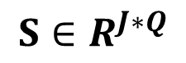
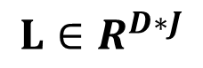
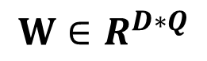

Prediction
High-level latent features
G groups; Q tasks; D-dimensional features.
Original (low-level) space
Latent (semantic) space
Semantic representation
J ≤ D
J is the feature dimension of latent space.
$$≈$$
$$×$$
$$W∈R^{D∗Q}$$
$$L∈R^{D∗J}$$
$$S∈R^{J∗Q}$$
Notes:
We assume that there are J latent features. Each task is defined as a linear combination of a subset of these latent features. We hence impose the l_2,1-norm on S instead of W to learn the group-sharing latent features.

Slide 23
Prediction
laTent grOup multi-task lEarniNg (TOKEN)
G groups; Q tasks; D-dimensional features.
Individual-specific feature learning
Avoid
overfitting
Loss function
group-sharing feature learning
Notes:
Apart from the group-sharing latent features, we also assume each task should be related to a few specific latent features, which is implemented by the l1 norm of S. This is the final objective function.

Slide 24
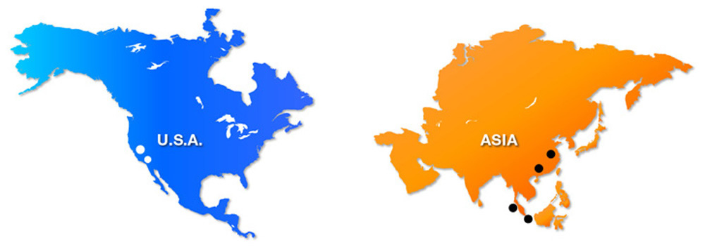

Prescription
Guideline Construction
Conduct a user study via AMT to build guidelines regrading disclosure norms in diﬀerent circles.
Launch a cross-cultural study within two distinct areas: the U.S. and Asia12, where for each area, we hired 200 subjects.
Questionnaire: a series of questions of whether he/she feels comfortable to share the given personal aspect to four social circles: Family members, Close Friends, Casual Friends and Outsider Audience.
Get two tables of guidelines, showing the privacy perception of users from the U.S. and Asia, respectively.
AMT
Questionnaire
Notes:
Now, we come to the final component---the prescription. This component details how to construct the guidelines and use the guidelines to recommend appropriate actions to user Although privacy may be subjective, there is still a societal consensus that certain information is more private than the others from a general societal view. We thus conducted a user study via AMT to build guidelines regrading disclosure norms in diﬀerent social circles. Considering the existence of cultural diﬀerence, we launched a cross-cultural study within two distinct areas: the U.S. and Asia. Each area, we employ 200 subjects to answer a questionnaire, which consists of a series of questions of whether he/she feels comfortable to share the given personal aspect to four social circles: Family members, Close Friends, Casual Friends and Outsider Audience.

Slide 25
Prescription
Action Suggestion
Based on the prediction component, we can infer which personal aspects have been leaked from the given UGC.
Once the privacy leakage is detected, we can remind users of what has been uncovered and accordingly recommend the appropriate UGC-level privacy settings.
Notes:
Now, if we can detect the privacy leakage from the given UGC with the previous prediction component, we can remind users of what has been uncovered and accordingly recommend the appropriate audience circles.

Slide 26
Experiment
Baselines
SVM: This baseline simply learns each task individually. We chose the learning formulation with the kernel of radial-basis function.
MTL_Lasso: The second baseline is the multi-task learning with Lasso [42]. This model also does not take advantage of prior knowledge about tasks relatedness .
MTFL: The third baseline is the multi-task feature learning [2], which takes advantage of the group lasso to jointly learn features for diﬀerent tasks.
GO-MTL (without taxonomy): The fourth baseline is the grouping and overlap in multi-task learning proposed in [27]. This model does not leverage the prior knowledge of task relations, as there is no taxonomy constructed to guide the learning.
Notes:
To verity the effectiveness of the proposed scheme, we choose these four baselines. The first one is the SVM, which learns each task individually.
The second one is the multi-task learning with lasso, which does not take advantage of prior knowledge about tasks relatedness.
The third one is the multi-task feature learning, which assumes that all tasks are related and share the common set of relevant features.
The forth one is the grouping and overlap in multi-task learning. This model also does not leverage the prior knowledge of task relations.

Slide 27
Experimental Results
Evaluation of Description
Table 3. Performance comparison of our model trained with different feature configurations. (%)
Notes:
To examine the discriminative features we extracted, we conducted experiments over diﬀerent kinds of features using TOKEN. Table 2 comparatively shows the performance of TOKEN in terms of diﬀerent feature configurations. It shows that combining all the features achieves the best performance.

Slide 28
Experimental Results
Evaluation of Description
Table 3. Performance comparison of our model trained with different feature configurations. (%)
LIWC
Content categories: ‘home’, ‘job’, ‘social’…
Style categories: pronouns (‘first’, ‘second’, ‘third’), verb tense (‘past’, ‘present’, ‘future’)…
self- or other-references and temporal hints
Notes:
In addition, we found that our model based on LIWC features achieves the best performance. One possible explanation is that the 70 categories of LIWC dictionary, including not only content categories such as home, job, and social that intuitively capture users' personal aspects, but also certain style (function) categories like ``pronouns'' and ``verb tense'' that provide the self- or other-references and temporal hints.

Slide 29
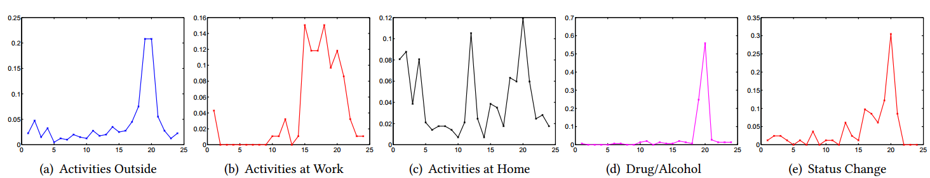
Experimental Results
Evaluation of Description
Figure 3. Illustration of temporal patterns regarding personal aspects. X axis: the timeline (by hour); Y axis: the distribution of tweets.
Notes:
Although meta-features only account for six dimensions, they also yield compelling performance. We argue that the timestamps of UGCs may play an important role regarding privacy leakage detection.
We thus had a closer look at the comparison among the time distributions of several representative categories in Figure 3. As can be seen, categories related to activities show prominent temporal patterns. For example, tweets related to users’ activities at home peak at around 12pm and 20pm, while those related to users’ activities outside of home and work are more likely to be posted at around 20pm.

Slide 30
Experimental Results
Evaluation of Prediction
Table 4. Performance comparison between our TOKEN model and the baselines in S@K and P@K (%).
Notes:
Table 3 shows the performance comparison between the baselines and our proposed TOKEN. First, we noticed that TOKEN outperforms the single task learning SVM. This verifies that there are relationships among tasks. This also shows the superiority of our work over other similar privacy detection researches, which enables us to draw a conclusion that it is eﬀective to learn tasks by groups, defined by the taxonomy.

Slide 31
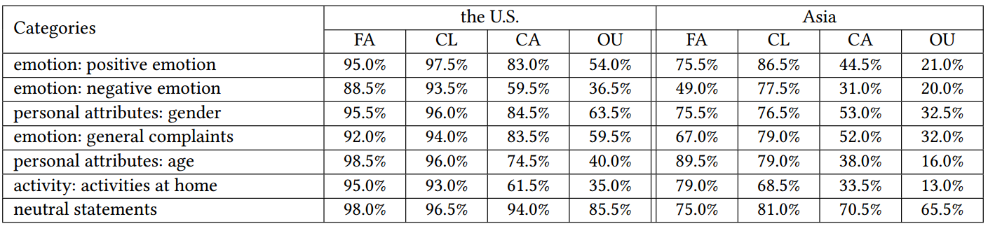
Experimental Results
Evaluation of Prescription Analysis
On the Cultural Privacy Perception
Table 5: The eight categories with the most diﬀerent privacy perceptions between the U.S. and Asia. The percentage of subjects who feel comfortable to share the given personal aspect to each social circle. FA: Family Member; CL: Close Friends; CA: Casual Friends; OU: Outsider Audience.
Notes:
Here we provide the insights regarding the guidelines obtained from the cross-culture user study. Table 5 shows the eight most diﬀerent privacy perceptions between users from the U.S. and Asia. As expected, it demonstrates the existence of cultural diﬀerence regarding privacy perception. Overall, the Americans are more open to share the listed personal aspects, especially their emotions, age and activities at home, as compared to the Asians.

Slide 32
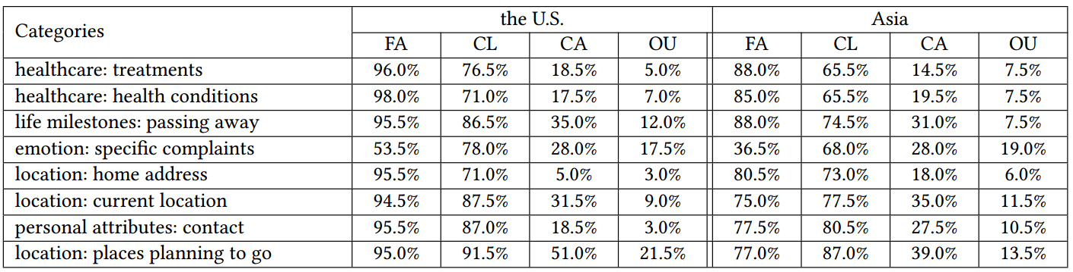
Experimental Results
Evaluation of Prescription Analysis
On the Cultural Privacy Perception
Table 6: The eight categories with the most similar privacy perceptions between the U.S. and Asia. The percentage of subjects who feel comfortable to share the given personal aspect to each social circle. FA: Family Member; CL: Close Friends; CA: Casual Friends; OU: Outsider Audience.
Notes:
In addition, Table 6 also demonstrates the existence of social consensus between diﬀerent cultures regarding the privacy perception. Interestingly, we observed that the categories on which users from
diﬀerent cultures achieve consensus are more private, as the majority of users agreed that these personal aspects should be kept private from the outsider audience.

Slide 33
Conclusion
We study the problem of privacy preserving by presenting a scheme, consisting of three components: description, prediction and prescription.
As to description, we build a comprehensive taxonomy, construct a benchmark dataset, and develop a set of privacy-oriented features.
Regarding prediction, we propose a taxonomy-guided multi-task learning model to categorize social posts, which is able to learn both group-sharing and aspect-specific features simultaneously.
In terms of prescription, we construct cross-culture guidelines regarding the user’s information disclosure norms based on the crowd intelligence via AMT.
Notes:
Let’s come to the conclusion of our work. We introduce a scheme, consisting of three components: description, prediction and prescription to study the problem of privacy preserving.
First, we build a comprehensive taxonomy to model users’ personal aspects, based on which we construct a benchmark dataset. Moreover, we develop a set of privacy-oriented features.
Second, regarding the prediction, we introduce a taxonomy-guided multi-task learning model to detect users’ privacy leakage. Last, we construct the cross-culture guidelines in terms of the users’ information disclosure norms from the AMT, based on which we can recommend the appropriate UGC-level privacy settings for users.

Slide 34
Future Work
Currently, we only explore the simple linear mapping to model the prediction component. However, the complicated prediction mapping may lie in the non-linear space.
We plan to extend our work towards applying the more advanced neural networks in our context.
Notes:
Currently, we only use the simple linear mappings to build the prediction model. However, the complex prediction mapping maybe nonlinear, which propels us to explore more advanced neural networks in the future.

Slide 35


Thank You
Notes:
That’s all. Thank you.

Slide 36
Back Up

Slide 37
Experimental Results
Evaluation of Description
Table 3. Performance comparison of our model trained with different feature configurations. (%)
Privacy_dictionary
Law, OpenVisible, OutcomeState, NormsRequisites, Restriction, NegativePrivacy, Intimacy, and PrivateSecret
Formal/ professional
Small-scale

